Slide 1
Final Group Project
Data Analytics Bootcamp
Anand Bajaj ⬤ Katrin Freitag ⬤ Matthew Lao ⬤ Boakye Twum-Donkor
Notes:
Kat
Alongside team members: Anand, Matt and Kobe

Slide 2

Topic of Interest: Customer Reviews
Positive reviews = Word of Mouth
Improved Business Model
Directed Advertisement
Notes:
Reviews are important to businesses as they provide a “word-of-mouth” advertisement approach
Not only can they be a deciding factor as to whether a customer will visit a business
Using our analysis, businesses can draw important conclusion by analyzing the most common words from reviews.
Frequently used words in reviews can furthermore be used in directed advertisement, for example on social media platforms

Slide 3

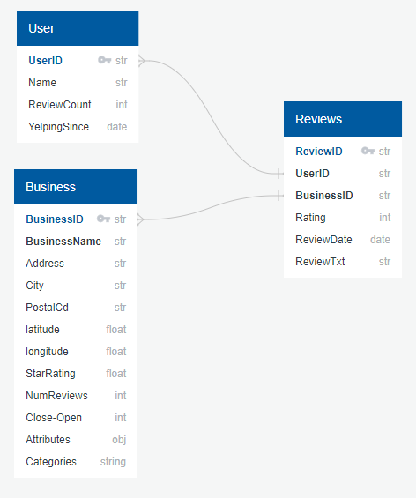
Data Source
To conduct the analysis, we are using the publicly available Yelp Dataset:
Users
Businesses
Reviews
Focus for this analysis: Italian Restaurants in California
Notes:
Yelp dataset seeing as yelp is a website where users can leave reviews for businesses they have visited
This worked really well for us because the reviews need to include text and have a star rating
For simplicity, focus on italian restaurants in California only

Slide 4
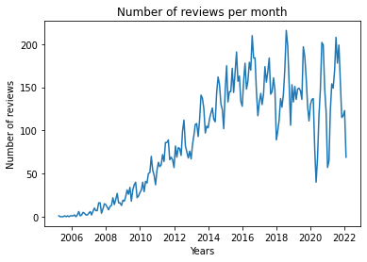
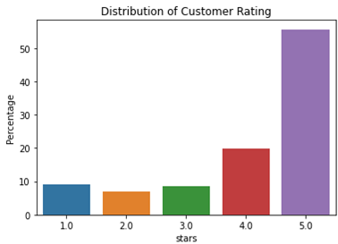
Initial Analysis
Notes:
Millions of reviews accumulated since 2005
Slow decrease in review count after 2016
roughly 70% of reviews on Yelp, are positive
This is where our idea came in to focus on negative reviews to see what are common words that businesses can use to improve their business model

Slide 5
How can a business utilize reviews to improve their business model and build a larger customer base?
Business Problem:

Slide 6
Data Preprocessing and Machine Learning
Positive Review | Negative Review
4 - 5 | 1 - 3
Supervised Learning:
Predicting whether a review is positive or negative based on star rating and polarity and subjectivity of a sentence.
Notes:
We categorized a review as “positive” if it has 4 or 5 stars
Reviews with star ratings from 1-3, are categorized as “negative/neutral”
Data preprocessing
Language requirements
Character removal
Tokenization
Supervised Learning: Natural Language Processing
Polarity and Subjectivity for Sentiment Analysis
Polarity assigns sentiment to a word or sentence fragment based on the range of [-1,1]
Subjectivity quantifies the amount of personal opinion and factual information contained in the text.

Slide 7
Output Model
Positive Sentiment Review Statement:
Negative Sentiment Review Statement:
“This restaurant is incredible, and has the best pasta carbonara…”
“We visited once and were really disappointed…”
Notes:
Machine learning model is able to predict whether a review is positive or negative with an accuracy between 83-88%
As an example
Logistic Regression Model - 86.5% accuracy
Support Vector Model - 85.1% accuracy
Multinomial Naive Bayes - 88.1% accuracy
Random Forest Classifier Model - 82.7% accuracy
Balanced Random Forest Classifier Model - 87.3% accuracy

Slide 8
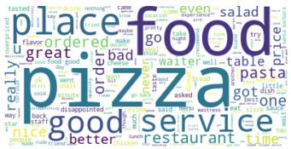
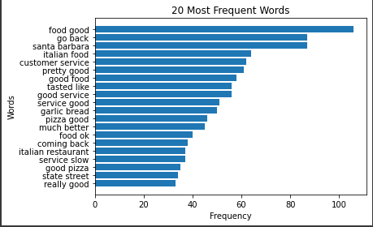
Takeaways from Exploratory Analysis
Most common words:
Food
Location
Service
Negative Reviews:
Location - Santa Barbara
Service
Notes:
Positive reviews can be used for business improvements and for the businesses to know what customer value most
Common words in all reviews were around food and location
For negative reviews in particular (from 1-3)
Results: Most important aspects for customers: service, location (Santa Barbara)
Negative reviews - focus on common words - services - increase customer basis

Slide 9
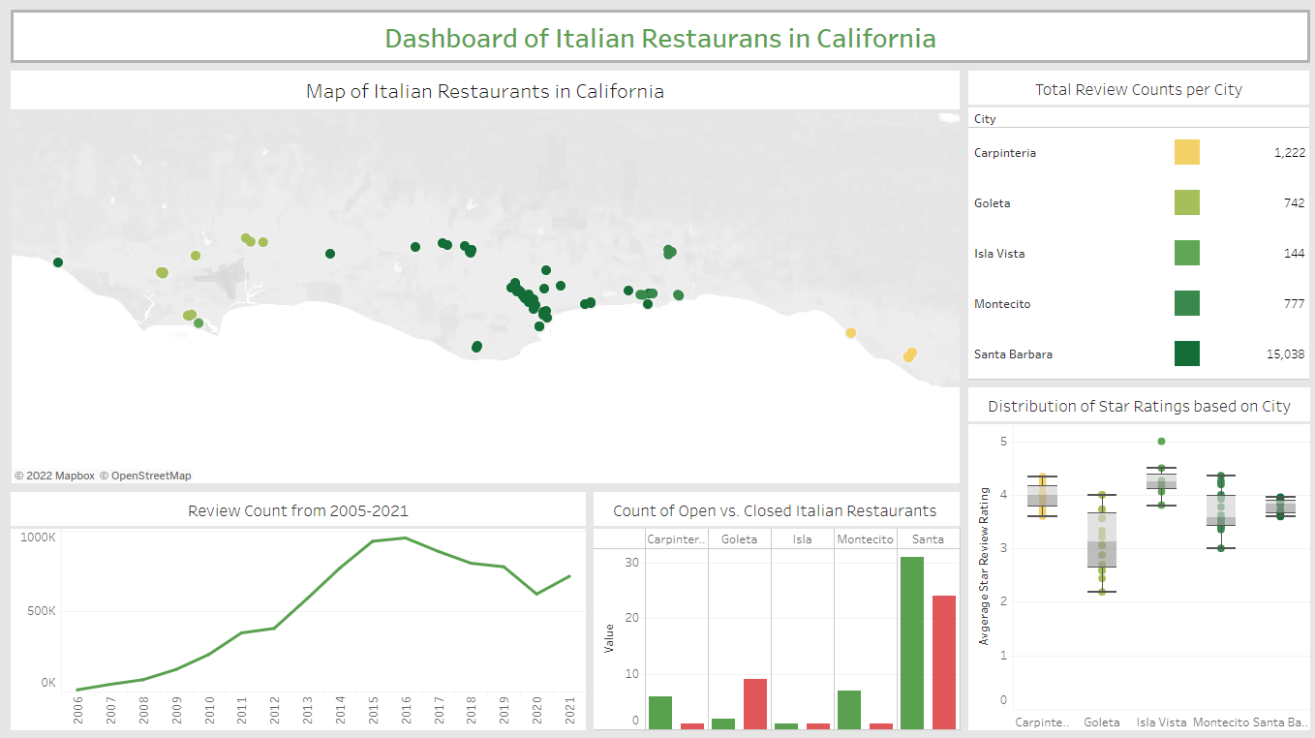
Notes:
Interactive map
Able to analyze each city by itself
Includes total review count per city
Distribution of star rating based on each city
How many open or closed restaurants each city has
Santa Barbara has the most reviews and locations
Santa Barbara came up for negative and positive reviews - negative reviews and closed businesses
Most consistent star rating as can be told by the boxplot graph
Review count consistent with data exploratory
More positive than negative reviews

Slide 10
Future Improvements
Notes:
Further improvements:
unsupervised learning
class train model - reviews without any ratings, model should be able to classify positive/negative reviews based on previous reviews
Topic modelling - classify based on different topics
Unsupervised machine learning would be better due to decline in yelp reviews being left and more data available on social media where there are no star ratings

Slide 11
Thank You!
Questions?

